Slide 1


Slide 2
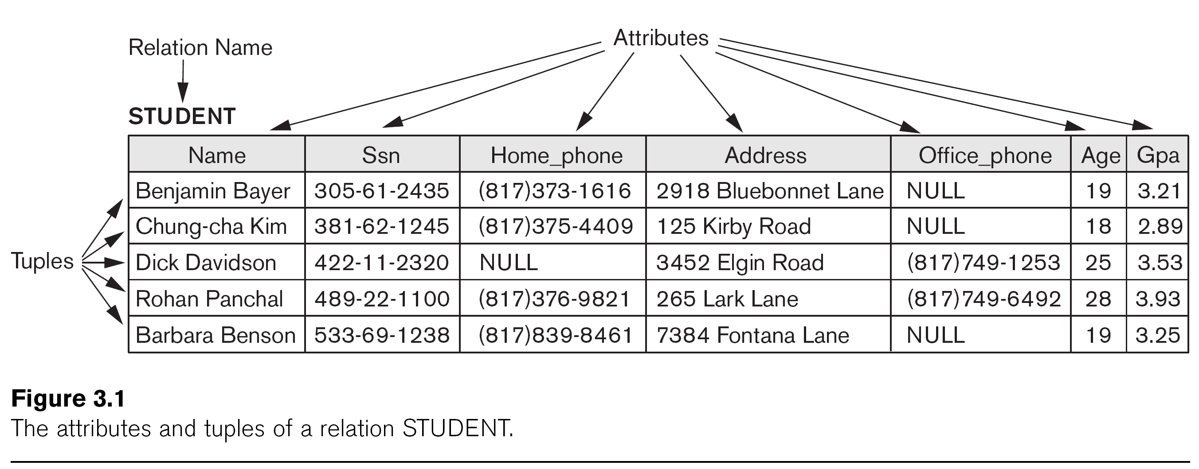

Slide 3


Slide 5


Slide 7
Continued next page…

Slide 10
